Slide 1


The Future of the Web: From Cloud to Edge using Server-Side Components, React 18, & Next.js 13
presentation by : Faiza Murtaza
Roll No : PIAIC71063
Presented to : Dr. Sir Zia -U-llaha Khan (Founder PIAIC)
Group : Islamabad – Batch 40 (Panaverse)
Email : FAIZAMURTAZA1990@GMAIL.COM

Slide 2
TODAY'S DISCUSSION
Outline
Introduction of Edge of Computing?
In Brief & Basic Components of Edge Computing
Edge Computing Vs Cloud Computing
Client Side Vs Server Side?
Benefit & Future of Edge Computing ?
What Is Edge AI?
What is REACT? & Features of REACT
What is NEXT.JS? & Features of REACT
Conclusion

Slide 3
Introduction
Edge computing is a distributed computing framework that enables data to be processed closer to where it is created

Slide 4
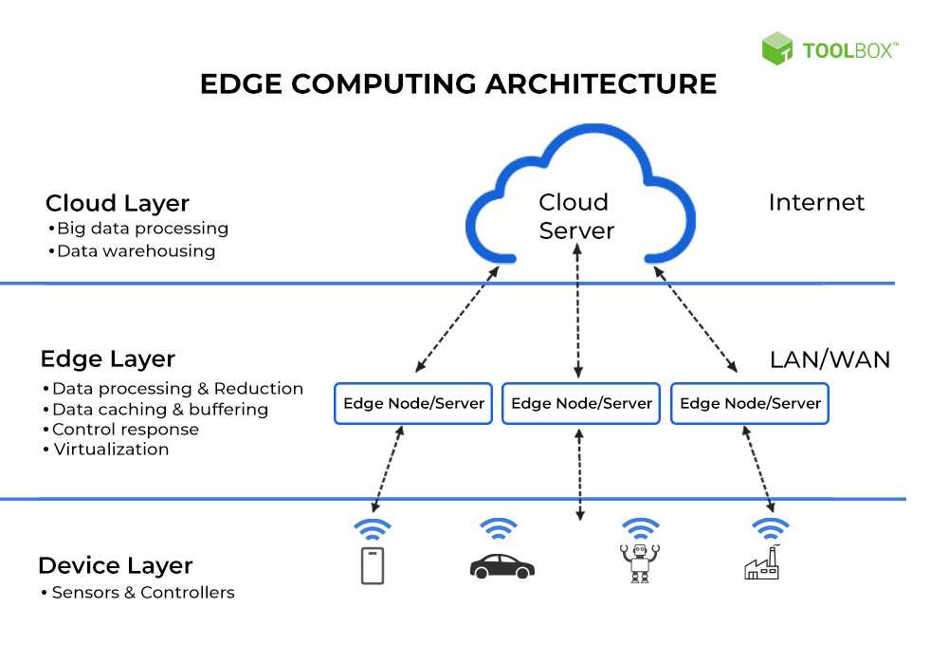
In Brief
Edge computing is defined as the practice of processing and computing client data closer to the data source rather than on a centralized server or a cloud-based location. At its simplest, edge computing brings computing resources, data storage, and enterprise applications closer to where the people actually consume the information.

Slide 5
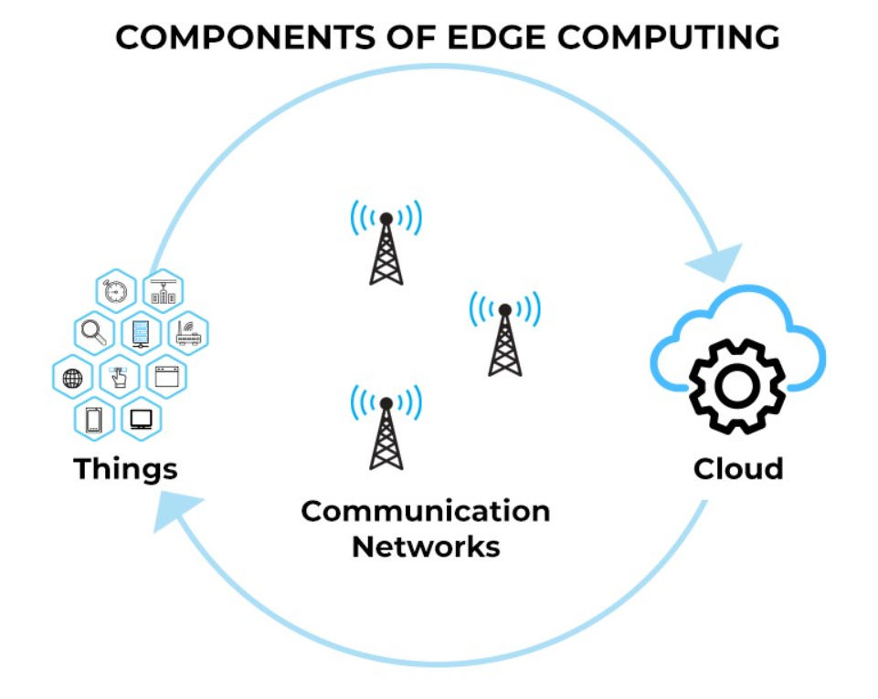
Basic Components of Edge Computing
Edge computing pays significant emphasis on locations. Accessing in-depth data from multiple locations equips businesses to deal with the demands of future customers.
It enables businesses to analyze critical data in real-time without sending it thousands of miles away.
Moreover, it is a crucial step forward for companies looking to create high-performance applications with low latency.

Slide 6
Continue…
Internet of things (IoT):
Businesses deploying IoT in edge computing capabilities close to devices gain the prowess to respond to new data in a matter of seconds.
Communication networks:
Edge computing has the ability to unleash the full potential of 5G. It enables data localization and ultra-low latency and addresses security and privacy concerns, thereby reducing the load on networks.
Cloud computing:
A predecessor to edge, cloud computing is a huge tool for storing and processing computer resources in a central data center. On the other hand, edge computing is a distributed model that is most likely to be used by those applications and devices that require quick responses, real-time data processing, and key insights.

Slide 7
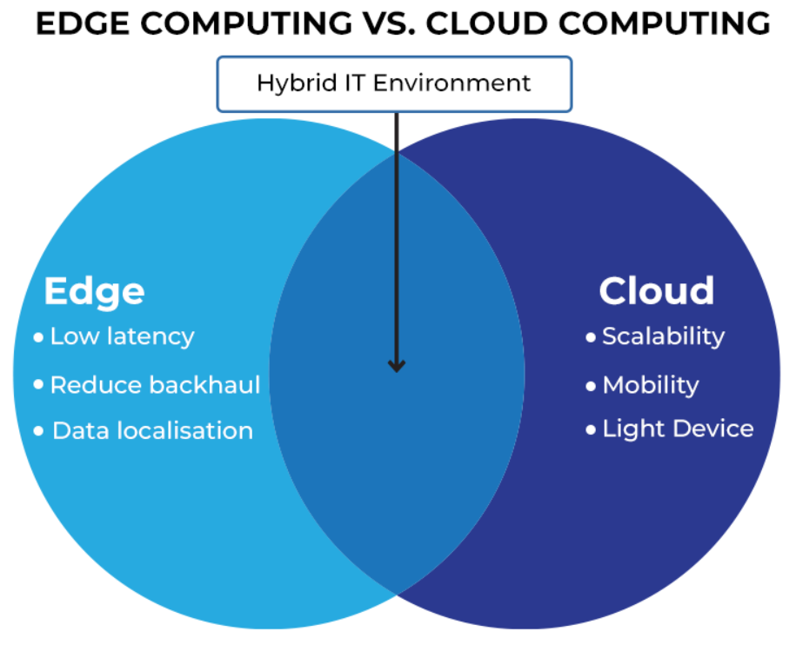
Edge Computing Vs Cloud Computing
Low Latency:
A computer network that is optimized to process a very high volume of data messages with minimal delay (latency).These networks are designed to support operations that require near real-time access to rapidly changing data. OR
The time that elapses in the communication between the client initiating the communication and the time it takes to receive the response.
Reduce Backhaul:
Low: Data is processed locally at the edge node, reducing backhaul costs.
Data Localisation:
emerging paradigm where data is processed near the edge of the network. Or
data is produced at a client endpoint

Slide 8
Edge Computing Vs Cloud Computing
Scalability:
The ability to increase or decrease IT resources as needed to meet changing demand.
Mobility :
balancing resources and costs between private and public cloud services, as well as the flexibility to adapt quickly to changes in markets, technologies or the business itself.
Light Devices :
street lamp monitoring.

Slide 9

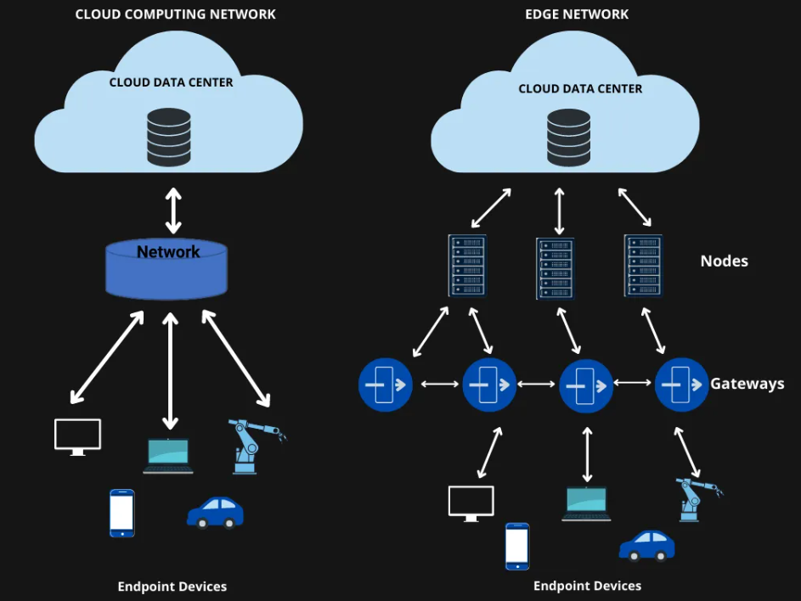
Are Edge Computing & Cloud Similar?
Edge Computing?:
No, because Edge computing is used to process information that is time-sensitive.
Cloud Computing?:
Cloud Computing is used to process data that is not time-sensitive.

Slide 10
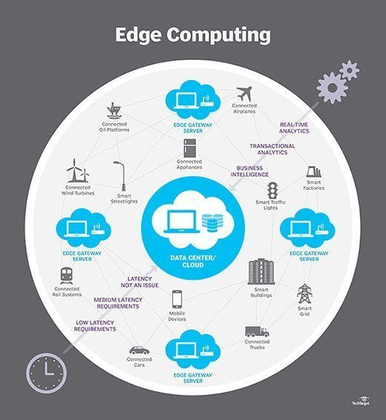
Applications of Edge Computing
Manufacturing
Oil rigs, mining, and gas industry
Financial services
Healthcare
Retail
Autonomous vehicles
Gaming
Smart cities
Video streaming

Slide 11
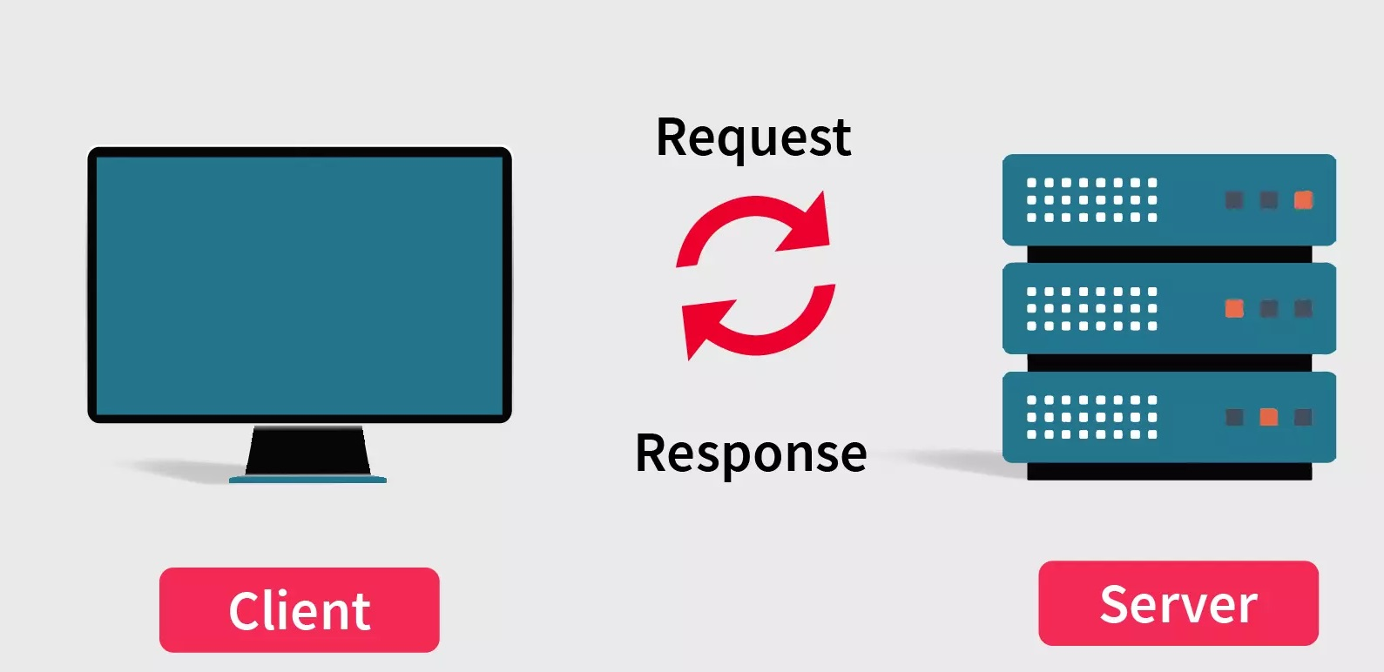
Client Side Vs Server Side
Client Side: Client side and server side are web development terms that describe where application code runs. Distinction as the frontend vs. the backend, although client-side/server-side and frontend/backend aren't quite the same.
In web development, 'client side' refers to everything in a web application that is displayed or takes place on the client (end user device). This includes
Text
Images,
Actions That Performs Within The Browser.
Server Side: means everything that happens on the server, instead of on the client. In the past, nearly all business logic ran on the server side, and this included
Rendering Dynamic Webpages
Interacting With Databases
Identity Authentication
Push Notifications

Slide 12

Benefits & Future Of Edge Computing
Autonomous Vehicles.
Electric Vehicles and Charging Stations and Traffic Management Systems.
Public Transit Systems.
Healthcare and Medical Applications.
Industrial Process Monitoring and Predictive Maintenance.
Agriculture.
Security and Worker Safety.

Slide 13
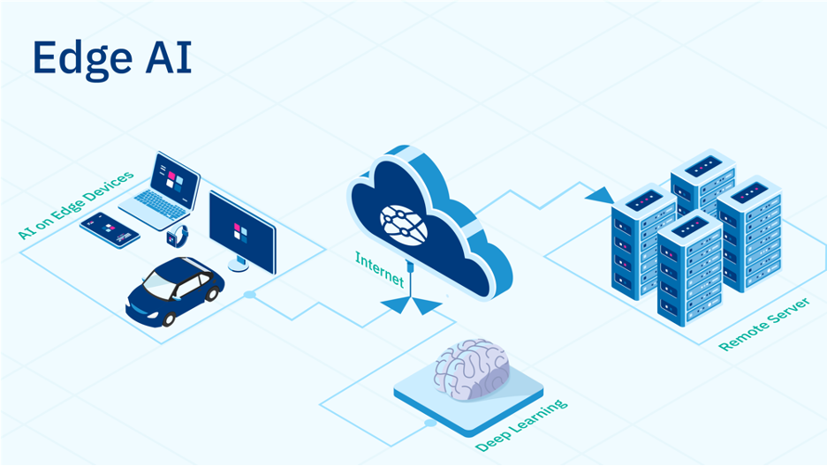
What is Edge AI & Benefit of Edge AI?
Edge AI is the deployment of AI applications in devices throughout the physical world. It’s called “edge AI” because the AI computation is done near the user at the edge of the network, close to where the data is located, rather than centrally in a cloud computing facility or private data center.
AI algorithms are capable of understanding language, sights, sounds, smells, temperature, faces and other analog forms of unstructured information, they’re particularly useful in places occupied by end users with real-world problems.
Mostly used in healthcare, self car driving & smart home technology

Slide 14

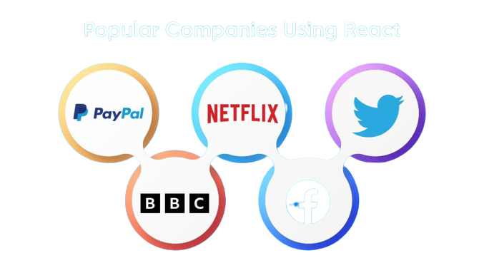
What is REACT?
React is a free open-sources fronted JavaScript library developed by Meta. It is used to build interactive UIs & Web Applications quickly and efficiently with significantly less code
React Apps are developed using reusable components. These components are assembled to create the final interface with client side rendering

Slide 15
Features of REACT?
Components: Building block of React App which can be nested and reused
JSX: JavaScript extension which make it easer to write and add HTML code in React
Components: Building block of React App which can be nested and reused
Virtual DOM: provides abstraction from DOM manipulation. Simple, fast and efficient rendering
MVC: An architecture that spilt the application layer into modal (database), View(Client) & controller (server)

Slide 16
Features of REACT?
Data Binding: One-Way data binding in which child components are nested within parents components.
Debugging: React developer Tools extension in Chrome Simplifies and Speeds up code debugging.

Slide 17
Components of REACT?
Components: Building block of React App which can be nested and reused
JSX: JavaScript extension which make it easer to write and add HTML code in React
Components: Building block of React App which can be nested and reused
Virtual DOM: provides abstraction from DOM manipulation. Simple, fast and efficient rendering
MVC: An architecture that spilt the application layer into modal (database), View(Client) & controller (server)

Slide 18

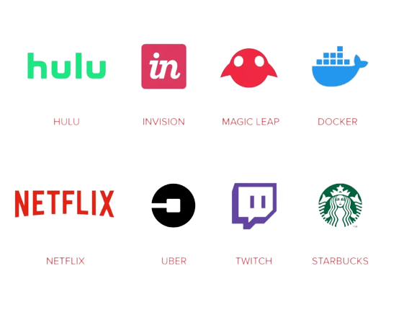
What is NEXT.JS?
Next.Js: front-end framework created by Vercel, which allow developer to easily build websites with React. It uses Node.Js, a JavaScript runtime, under the hood which makes it possible to execute Java Script Sever-Side.
Next.Js: Next.js runs the React part on the Server, with dynamic generation, rendering happens on the server where it generates the HTML, so it is not rendered in the client every time. Using this method, we receive HTML upon request instead of JavaScript.
Next.Js: offers better SEO(Search Engine Optimization), more accessible URLs & enhanced performance of application.

Slide 19
Features of NEXT.JS?
Server Side Rendering(SRR): Developers can render the JavaScript code on the Server which allow them to send Simple indexable HTML to the user. Next.Js made this rendering possible. It works on issue like caching, server load, on-demand content, and the architecture of the application.
Static Site Generation: This method generates HTML in the build time rather during the runtime. This type of website is exceptionally fast but not as suitable as SSR for an interactive web application because it thrives on user input and changes based on the incoming input.
Incremental Static Regeneration (ISR): ISR provides the best of both worlds. It can create or update content without redeploying the site, Working like an advanced cache. ISR has three main benefits for the developers, better performance improved security & faster build times.

Slide 20
Conclusion: The Future of Web
The latest trend in web development is straightforward to optimize the user experience without compromising backend performance
Next.Js has become popular with large companies for its perforamance, extesibility and easy configuration. There is no framework that can achieve the same search engine optimization result, while also providing the tools to execute complex development
With the latest version of Next.Js (Next.Js 13), we have access to the Edge Rendering. This allows to deploy SSR & API routes at the edge
Edge functions allow developers to run their code at the Servers distribution globally. This means your code will be excuted at the location that is closest to your user. You can think of Edge functions as the Servers functions which are run at he CND Infrastructure

Slide 21
Any Query ?

